Slide 1
BME 590 Final Project:
1-year Mortality Prediction using MIMIC-III Database
Fanjie Kong, Mengxuan Cui and Xinghong Tang
Notes:
Our final project is …
I am …

Slide 2
Outline
Introduction to Problem
Introduction to MIMIC-III Database (Exploratory Data Analysis)
Feature Selection and Data Preprocessing
Feature Scatter Plot
Importance of Normalization and Data Augmentation
Modeling
Model Selection, Cross Validation and other technical details
Result
Comparison of Model Comparison Table
Feature Importance
Conclusion
Notes:
We are going to make an introduction to our topic as well as our EDA. Then is how we select and manipulate the data. Last we put the data into the models we select and see what we can find.

Slide 3
Introduction to Problem
Motivation:
One of the primary outcomes of interest of a hospital admission
Recommend specialized course of action
1-year Mortality Prediction:
one year after being discharged from the hospital.
prediction as a binary classification task
Notes:
1-year Mortality Prediction is one of the primary outcomes of interest of a hospital admission. Say, if a patient is predicted dying within 1 year, more specialized course of action should be involved to avoid mortality.
I say one year I mean within one year after most recently being discharged from the hospital. We formulate prediction as a binary classification task， 1 for yes, 0 for no

Slide 4
Introduction to MIMIC-III Database
Admissions | Admittime, Dischtime
 | Deathtime
 | Hospital_Expire_Flag
PATIENTS | Gender
 | DOB, DOD
 | EXPIRE_ID
Diagnoses_ICD | SEQ_NUM
 | ICD9_Code
ICU stays | LOS
LabEvents | WBC
 | RBC
 | Glucose, etc
Prescriptions | Drug
Variables need further exploration
Notes:
We went through all the tables, read some reference,
and then decided to explore more about these listed variables

Slide 5
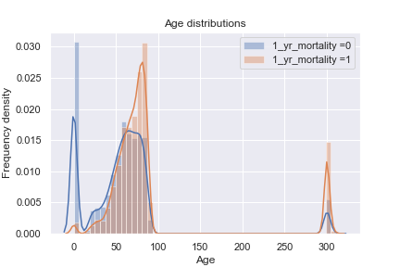
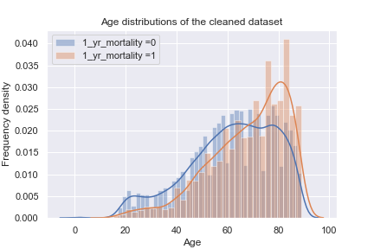
Introduction to MIMIC-III Database (EDA)
Demographic Features: Age
Delete Outliers
Notes:
We first plot their age distribution, (blue for survival and red for dead)
We hope to focus on whose age is between normal range.
Rule out newborns and whose age is extremely large.
46520 (7874 newborns + 199>300-year-old) 36655

Slide 6
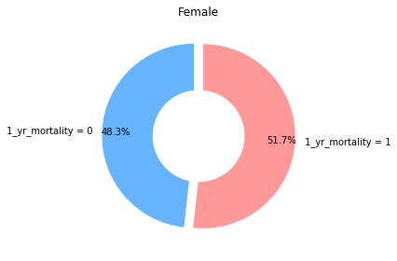
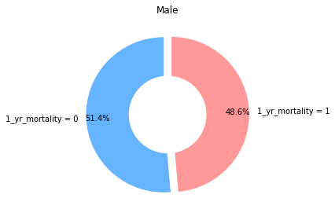
Introduction to MIMIC-III Database (EDA)
Other Demographic Features: Gender
Notes:
We explore the difference between female and male. It seems that female are more susceptible.

Slide 7
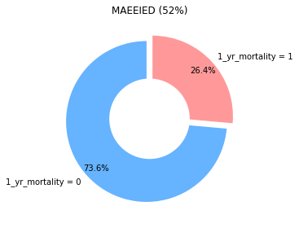
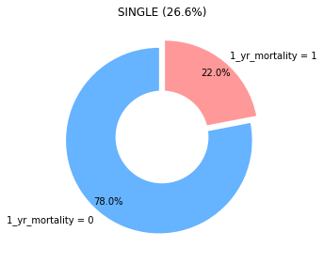
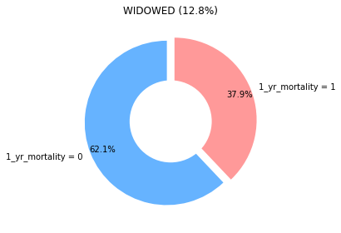
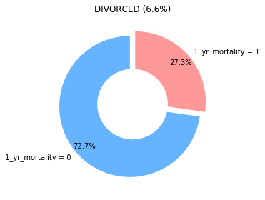
Introduction to MIMIC-III Database (EDA)
Other Demographic Features: Marital Status
Notes:
We also investigate patients marital status. Only widowed show obvious difference and we think it might because their old age.

Slide 8
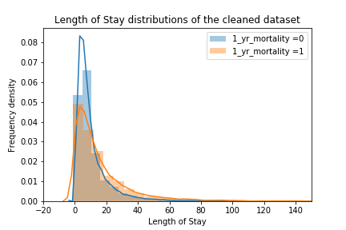
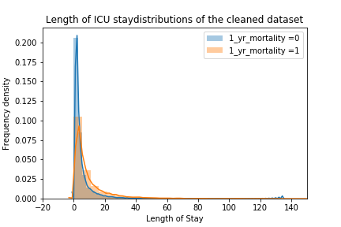
Introduction to MIMIC-III Database (EDA)
Admission information: Length of Stay and Length of Stay (ICU)
Notes:
Then we explore some number features, such as their total length of stay in hospital, their total length of stay in ICU.
We can pay more attention to the non-overlapping area. Patients die within 1 year seems to have longer stay both in hospital and in ICU

Slide 9
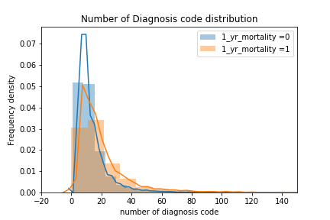
Introduction to MIMIC-III Database (EDA)
Diagnostic information: number of diagnosis code
Notes:
The total number of diagnoses shows the same result.

Slide 10
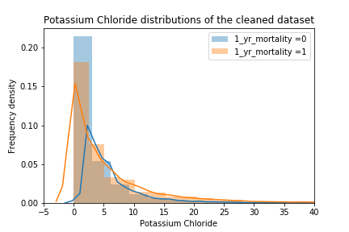
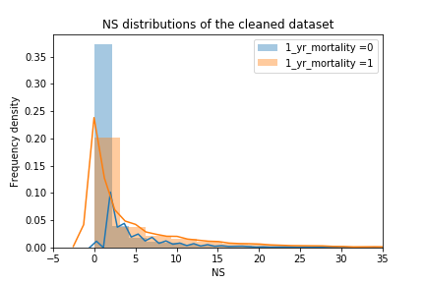
Introduction to MIMIC-III Database (EDA)
Prescription: Potassium Chloride and NS
Notes:
We also choose 2 prescriptions that show obvious difference between patients die within 1 year and patients not.
We can easily see the peak shift to larger number for patients die within 1 year.
Prescription: Potassium Chloride and NS, All patients
Two typical
Shift

Slide 11
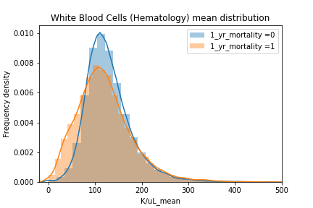
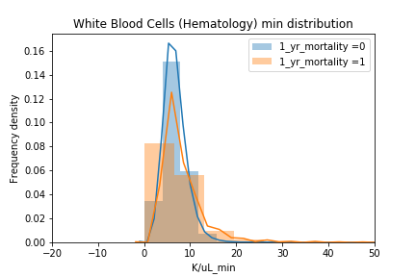
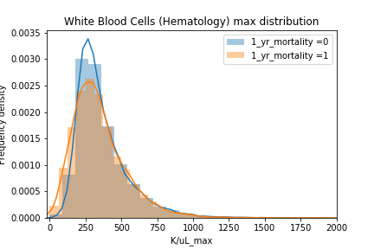
Introduction to MIMIC-III Database (EDA)
Lab Values: White Blood Cell (mean, max and min)
Notes:
We start our examination into lab values with a common test, white blood cell count in blood test. Tests usually have values within certain bounds. Therefore we took average, max and min values of WBC counts of a patient's all tests. However, we could see some difference for these numerical values from the plots but not significant.

Slide 12
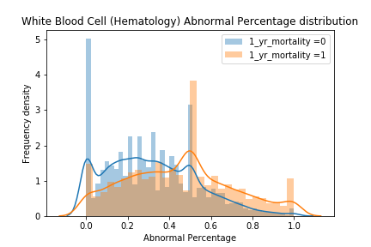
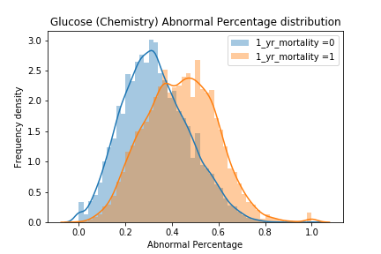
Introduction to MIMIC-III Database (EDA)
Lab Values: Abnormal Percentage (WBC and Glucose)
Notes:
Then, we wanted a more effective indicator. We found there is a flag value indicates the abnormality of every lab test in each lab item. We calculate the abnormality percentage and this time the difference between two outcomes is obvious. Which makes sense in reality, the higher the percentage, the higher the risk of mortality. This feature is also very effective for glucose value.

Slide 13
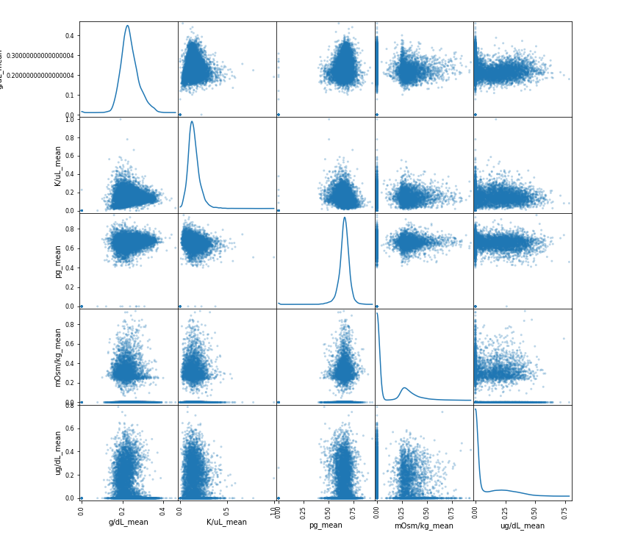
Feature Selection and Data Preprocessing
Scatter Plot Matrix of Lab Events
Look for correlation between each two variables
Look like a line:
stronger linear relation
Look like a mass
stronger nonlinear relation
Notes:
Other than plotting Kernel density estimation for our features, we also conducted a scatter plot matrix, which helps us check the redundancy of our features. For example, the left figure show plots between each two average lab values. The masses indicate they are mostly nonlinear. Which means we could possibly include all lab values in our feature sets.

Slide 14
Feature Selection and Data Preprocessing
Admission specific | Length of stay in hospital
Demographics | Age, gender, ethnicity, marital status.
Lab Results | Number of abnormalities of lab results, WBC, RBC, glucose, hemoglobin, hematocrit, platelets, Antidiuretic hormone, sweat chloride, quantitative immunoglobulins, Erythrocyte sedimentation rate, arterial blood gasses, etc.
ICU Information | Length of stay in ICU
Prescription | Number of drugs received, like Insulin, D5W, Furosemide, Metoprolol, Calcium Gluconate, etc.
Diagnosis | Number of diagnoses
Variables included in each dataset
Notes:
This is a summary table of all features that we select based on previous paper results, our exploratory data analysis and scatter plot matrix, consisting of 6 major categories, 256 features in total after one-hot encoding.

Slide 15
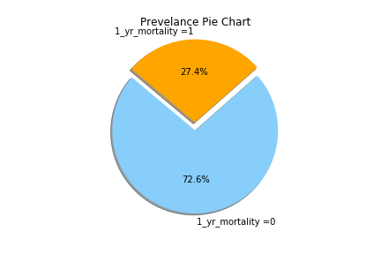
Feature Selection and Data Preprocessing
Data Normalization:
Eliminate the effect of outliers
Increase convergence rate of gradient descent
May increase accuracy in model evaluation
Deal with Imbalanced Data:
Try Generate Synthetic Samples
SMOTE(Synthetic Minority Over-sampling Technique)
Use metrics such as AUC score, Precision, Recall and F1 Score other than accuracy in model evaluation
Notes:
For data preprocessing, we mainly did two things: data normalization, which is a very common method to avoid the effect of outliers, to increase the convergence rate for gradient descent model such as artificial neural network, a model we later tried, and may increase the accuracy score.
We have a imbalanced dataset with 27.4% prevalence of mortality. We use a technique called SMOTE to generate synthetic samples which has outcome of death. We use more metrics

Slide 16
Modeling
1. Logistic Regression -- Linear model
2. Random Forest -- Ensemble model
3. Artificial Neural Network -- Deep learning model
Notes:
In our modeling part, we try 3 different kinds of models to solve our task.
We first start with a very simple linear model. Logistic regression
Then, we try to use random forest, a very typical ensemble model
Finally, since . deep learning model can do lots of amazing thing today and we have a large amount of data, we choose artificial neural network to solve our task.
Logistic Regression model. Has lowest complexity.
Random forest. Ensemble, ensemble multiple randomly generated decision trees
Artificial neural network. It is currently very popular architecture for predictive model. Deep learning nowadays can do lots amazing things because it has strong representational power to approximate any functions.

Slide 17
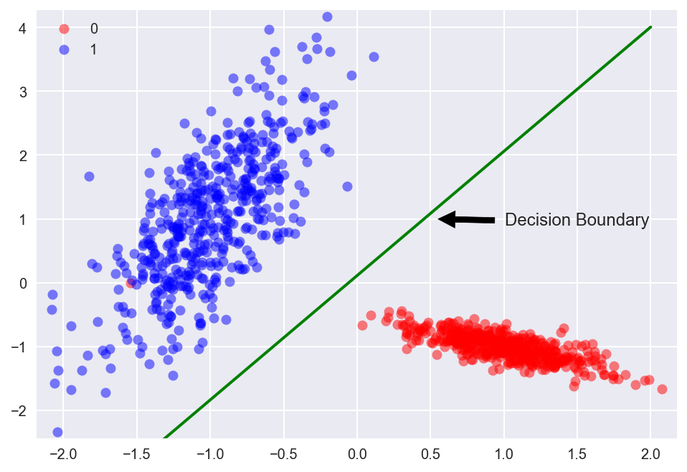
Modeling
1. Logistic Regression
2. Random Forest
3. Artificial Neural Network
Reference: https://github.com/trekhleb/machine-learning-octave/tree/master/logistic-regression
Notes:
Simple, general
Logistic Regression model. Has lowest complexity.
It is linear model because its decision boundary is a linear hyper-plane.
Perform good on linearly separable dataset

Slide 18
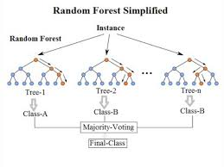
Modeling
1. Logistic Regression
2. Random Forest
3. Artificial Neural Network
Reference: https://medium.com/@williamkoehrsen/random-forest-simple-explanation-377895a60d2d
Notes:
It is a widely-used ensemble model. Decision tree is easy to overfit dataset. Random Forest algorithm basically ensemble randomly generated decision trees. This algorithm improve the generalization of decision trees.
Don’t need to scale the data
Perform good on non-linear problem
Fast algorithm if we use parallel computing
4. Still easy to overfit
5. It has a limitation of its performance. Performance is hard to improve if we have more samples.
6. Sensitive to hyper-parameters.

Slide 19
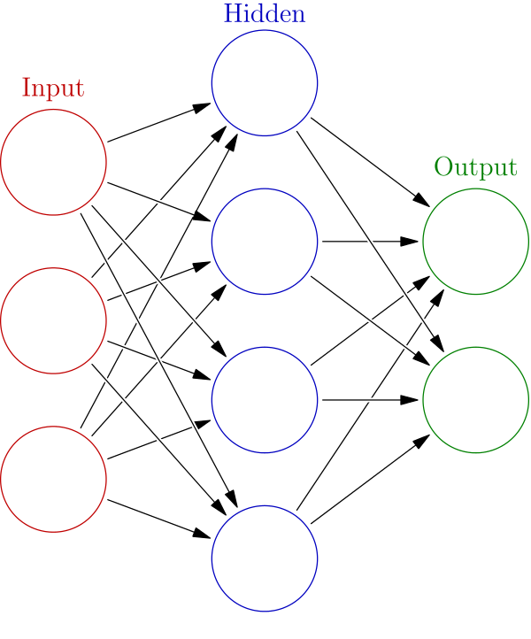
Modeling
1. Logistic Regression
2. Random Forest
3. Artificial Neural Network
Reference: https://en.wikipedia.org/wiki/Artificial_neural_network
Notes:
Most powerful model nowaday. Perform amazingly on some hard problems. Alpha-go zero can beat human chess player.
Feedforward fully-connected neural network
1 . Large amount of data
2. Training slow
3. Strong expressive power
4. Generalization well

Slide 20
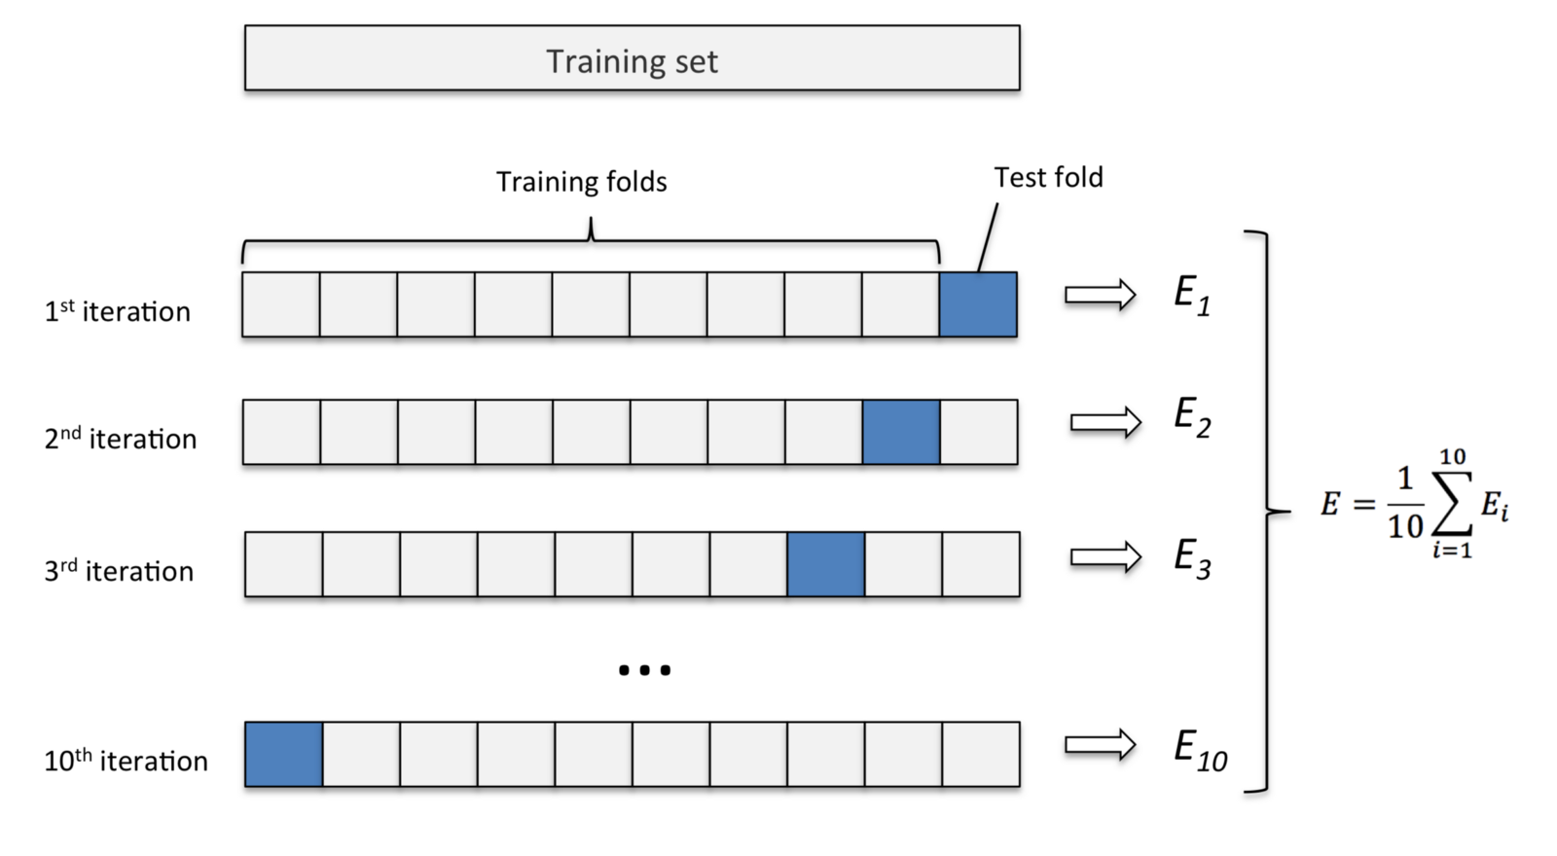
Cross validation and tuning hyper-parameters
Reference: https://medium.com/@sebastiannorena/some-model-tuning-methods-bfef3e6544f0
Notes:
Estimate the generalization performance of a model. We use it to tune hyper-parameters. In K-fold cross-validation, the training data are split once and for all into K equal sized sets chosen at random. Then train our model on (K-1) dataset. Test on the other one dataset not involved in training. Do the same thing K times but every time we use different pieces of dataset. (Approximate)

Slide 21
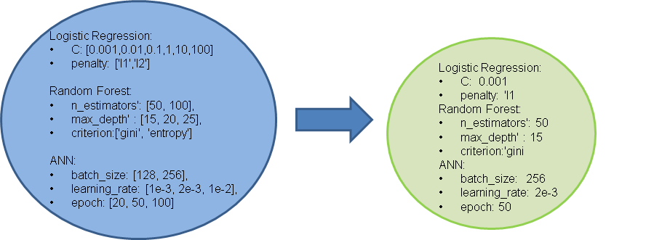
Cross-validation and tuning hyper-parameters
5-fold cross validation

Slide 22
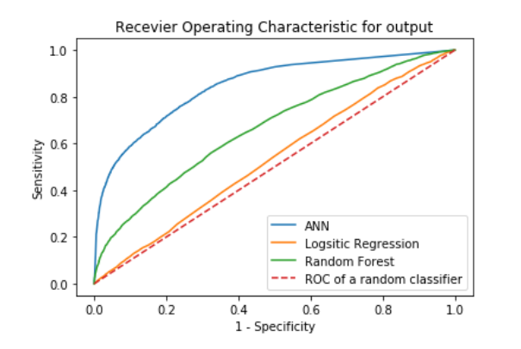
ROC Curve
Notes:
ROC curve show the ability of discrimination of the model. The curve is closer to the upper left corner, the better it is. The blue curve is the roc curve of ANN. We can see that ANN has the best shape and it has highest AUC scores.

Slide 23
Metrics Comparison Table
Model | Accuracy | Precision | Recall | F1-score | AUC
Logistic Regression | 0.7285 | 0.5 | 0.0003 | 0.0007 | 0.522
Logistic Regression(Oversampled) | 0.5103 | 0.2726 | 0.5044 | 0.3539 | 0.5317
Random Forest | 0.8018 | 0.9844 | 0.2743 | 0.4291 | 0.6958
Random Forest(Oversampled) | 0.6875 | 0.2834 | 0.0783 | 0.1268 | 0.5732
ANN | 0.8864 | 0.8278 | 0.7344 | 0.7783 | 0.9099
ANN (Oversampled) | 0.8425 | 0.7264 | 0.7024 | 0.7142 | 0.8562
Notes:
We use five metrics to measure the performance of our models, which are accuracy precision, recall, f1-score and area-under-curve(short for AUC).
We also compare the performance of models between using oversampling method SMOTE and not using.
We can see that ANN model without oversampling has the best performance on our task.
Also, we find oversampling using SMOTE technique improves Logistic Regression performance I think the reason is that Logistic regression is sensitive to the ratio of positive samples and negative samples. While it makes Random forest and ANN’s performance suffer becuase it add too much noise to the training data.

Slide 24
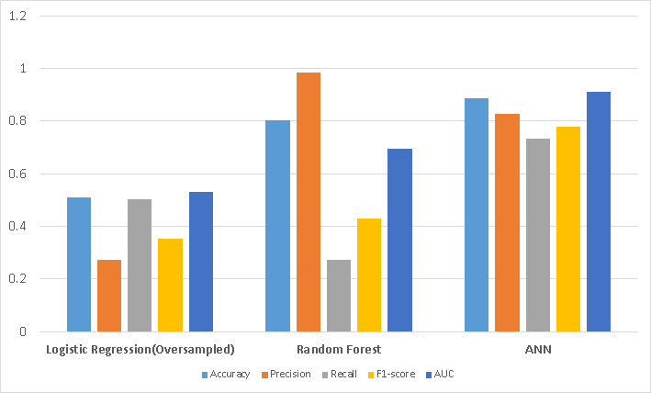
Metrics Comparison Table
Notes:
We also make a bar plot to show that ANN outperform the other models generally. Although Random forest has a very high precision, we find that it is because the random forest overfit the data and it

Slide 25
Conclusion
Prediction:
Neural Network Model performs best among these machine learning models
Limitation and Improvement
Lack of interpretability of features
Use statistical methods to get p-values of different variables for statistical significance analysis
Investigate the relation between mortality and notes based on NLP models
Notes:
Among the machine learning models that we apply, multi-layer perceptron, a deep-learning model, outperforms other models by an AUC score of over 20%. One of disadvantage of those machine learning model is lack of interpretability of features. We could show feature importance using F-score provided by XGBoost. However, we could get more insight and more confidence on feature evaluation if we could use statistical methods such as Chi-square test to get p-values of different variables. For this project, we leave note events untouched. Natural Language Processing(NLP) is a very popular direction right now in machine learning. It is worthy if we could investigate the relation between 1-year mortality and clinical notes by applying NLP models.

Slide 26
Reference
Barrett, Laura A., et al. "Building Computational Models to Predict One-Year Mortality in ICU Patients with Acute Myocardial Infarction and Post Myocardial Infarction Syndrome." arXiv preprint arXiv:1812.05072 (2018).
Purushotham, Sanjay, et al. "Benchmark of deep learning models on large healthcare mimic datasets." arXiv preprint arXiv:1710.08531 (2017).
Tyler, Patrick D., et al. "Assessment of Intensive Care Unit Laboratory Values That Differ From Reference Ranges and Association With Patient Mortality and Length of Stay." JAMA network open 1.7 (2018): e184521-e184521.
Fuchs, Lior, et al. "Quantifying the mortality impact of do-not-resuscitate orders in the ICU." Critical care medicine 45.6 (2017): 1019.
Lokhandwala, Sharukh, et al. "One-year mortality after recovery from critical illness: A retrospective cohort study." PloS one 13.5 (2018): e0197226.
https://github.com/YaronBlinder/MIMIC-III_readmission

